Slide 1


SALARY
PREDICTION
-Manav Padwal

Slide 2
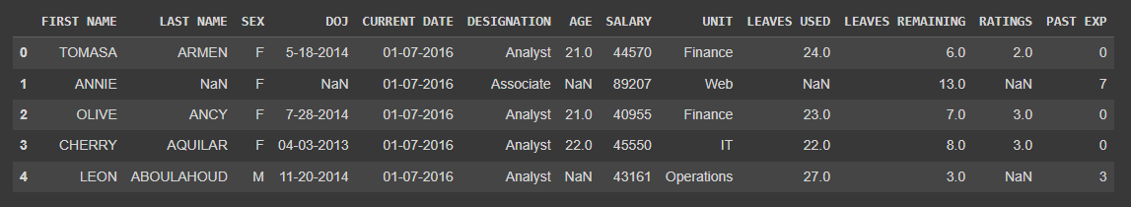
DATASET

Slide 3

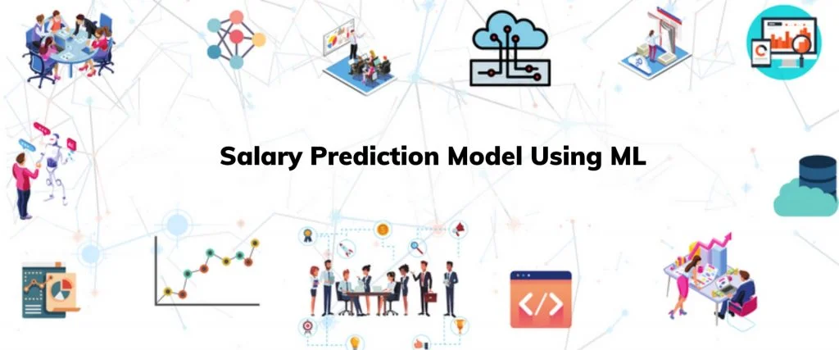
TASK SELECTION

Slide 4
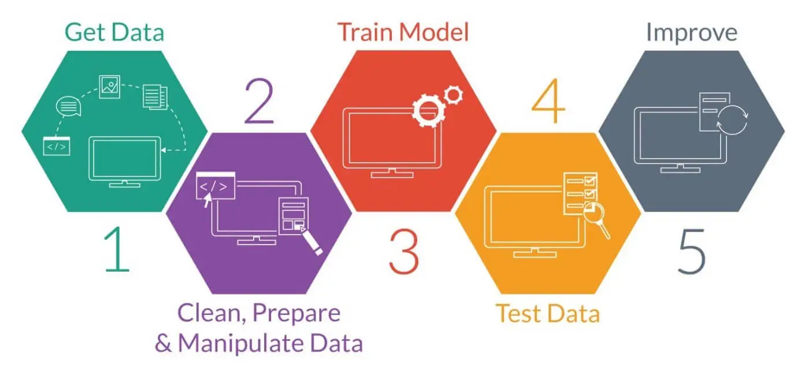
STAGES

Slide 5
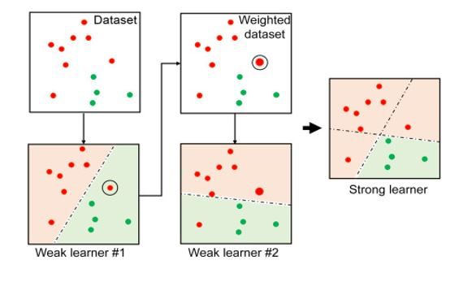
IMPROVIZATION
Using ADA boosting
combines multiple weak learners to create a strong learner
to improve the predictive performance of the linear regression model

Slide 6

THANK YOU

